Slide 1
Laboratory Training
MTN-027
Wayne Hall
MTN Network Laboratory
Magee-Womens Research Institute
Pittsburgh, PA

Slide 2
Directory
Overview of Lab testing……..
Specimen Labeling…………..
LDMS………………………….
Urine…………………………..
  Collection…………………
  hCG……………………….
Dipstick & Culture……….
Blood…………………………..
  Collection…………………
  HIV………………………..
  Syphilis……………………
  Plasma Archive………….
  Blood PK………………….
Vaginal………………………...
  Gram Stain……………….
  Culture……………………
4
5
7
10
10
11
12
13-21
13
16
18
20
21
22-41
22
25
  pH & Wet Mount……………...
  Trichomonas, GC/CT.………..
  Swab for Biomarkers.............. Swab for PK ………………..…
    ENR & Vis 28……………..
  ENR visit flow…………….
  Single Time point………..
  Scale Readiness………..
  Self-Collected Swab…….
  IntraVaginal Ring (VR)……….
Cervical Biopsy's ………………….
Cytobrush (Pitt & Case) ………….
Rectal Fluid Collection……………
Supplies…………………………….
MTN Contacts …………………….
26
27
28
29
29
30
31
32
36
40
42
44
45
47
48

Slide 3
SSP Section 9
Laboratory Considerations
The Lab SSP is a good resource for:
  sample collection and lab procedures
Make sure you have the most current version
Available at www.mtnstopshiv.org
Updates will be sent to you

Slide 4
9.1 Overview & General Guidelines
  Common information about safety, study sites, and test table summaries.
  Name change: Network Lab (NL) is now Lab Center (LC)
  4 Handy Tables:
    Overview of Lab Testing Locations, Sample type, & Methods
    Overview of Specimens for Storage and Shipment
    Overview of Laboratory Testing (9-3 in the SSP)
      Wayne’s favorite table!
    LDMS Specimen Management Guide

Slide 5
9.2 Specimen Labeling
All specimen containers are labeled with SCHARP-provided Participant ID (PTID) label.
All sample containers must have a Collection date and Visit code.
Do not exceed specimen volumes as described in the informed consent.
If information is handwritten, use indelible ink.
Notes:
Note: Common Sharpies are not completely indelible…the ink can be removed easily with alcohol… Use a pen or a Sharpie that is alcohol resistant!

Slide 6
9.3 Special Circumstances
A specimen will be recollected if samples cannot be tested (Ex. Purple Top broke on transit to the lab).
A protocol deviation (PD) form may be required in cases when additional specimens are recollected either due to a laboratory or clinic error.

Slide 7
9.4 Use of LDMS
Laboratory Data and Management System (LDMS)
All sites will be required to maintain the current version
Each site must export its LDMS data to Frontier Science (FSTRF) on a weekly basis.
Record all weights on the LDMS tracking sheet and excel data worksheet (supplied by LC).
  Processing lab will use the excel worksheet to calculate the Net weight to be placed into the LDMS data program.
Notes:
LDMS is a program used for the storage and shipping of laboratory specimens.

Slide 8
Table 9-4: LDMS Specimen Management Guide
  Is a good quick reference for codes & sample processing information
Example of Table 9-4 information:
Test | PRIMARY SPECIMEN | PRIMARY ADDITIVE | ALIQUOT DERIVATIVE | ALIQUOT SUB ADDITIVE/ DERIVATIVE | Aliquot volume | Units | INSTRUCTIONS FOR PROCESSING LAB
Plasma for Storage (archive) | BLD | EDT | PL1/2 | N/A | 1.5-2.0 | mL | Prepare as many 1.5 mL aliquots as possible with a total volume of aliquots ≥ to 3 ml. If sample is collected and held at room temp, freeze within 4 hours. If refrigerated after collection, freeze within 24 hours.
Table 9-5: LDMS Codes:
BLD: Whole Blood | GRS: Gram Stain | PL1/2: Single or double spun plasma
BPS: Biopsy | IVR: Used Intravaginal Ring | SWB: Swab
BTM: Biopsy Transport Medium | N/A: Not Applicable | SLD: Slide
CVB Cervical Biopsy | NON: No Additive | SPG: Sponge
CER: Cervix | PAC: Port-a-Cul or BD Max V (culture transport medium) | REC: Rectal
CTB: Cytobrush |  | RPM: RPMI Transport Media
EDT: EDTA | PBS: Phosphate buffered saline | VAG: Vaginal Swab

Slide 9
Pitt and UAB
have different
Cytobrush requirements
All weights are placed on LDMS Tracking sheets.
The Net weights will be recorded into LDMS via the weight worksheet

Slide 10
9.5 Urine Specimen Collection
Participant should not have urinated within one hour prior to urine collection
Collect in a sterile, plastic, preservative-free screw-top urine collection cup labeled with a PTID label.
Instruct the participant not to clean the labia.
Collect a mid-stream urine when collecting for urinalysis, culture, and/or pregnancy test.
Notes:
Mention the ‘if indicated’ tests (Urine Dip Stick and Urine NAAT for GC/CT). These tests can be performed per local standards (the urine NAATs in PGH can come to the Network lab).

Slide 11
9.5.1 hCG Pregnancy Test
  Kits that can be used:
    Quidel QuickVue Combo hCG urine/serum pregnancy test
    Quidel QuickVue One-Step hCG urine
    Fisher HealthCare Sure-Vue Urine hCG
  Testing done at local/clinic lab
  Interfering factors
    Excess blood or extreme cloudiness due to amorphous or mucus
      spin down and perform test on urine supernatant
    Gross hemolysis making the test difficult to read
      Urine will need recollected.

Slide 12
9.5.2 Urine Dipstick UA
Only Leukocytes, Nitrites, Protein, and Glucose are recorded.
9.5.3 Urine Culture
Perform only if clinically indicated (symptomatic)
Collect a mid-stream urine
Notes:
If a pregnancy & UA are collected for together, do Pregnancy test first & then UA.

Slide 13
9.6 Blood Collection:
Serum Tests:
  Gold top (serum separator), Tiger top (serum separator), or red top (plain no-additive) tube are all acceptable
  Alanine transaminase (ALT), Aspartate aminotransferase (AST), Creatinine, Syphilis, HBsAG, Anti-HCV, and HIV (EIA) testing.
Lithium Heparin Plasma: Light Green top
  invert at least 8 times after specimen collection
  May be the tube of choice for Chemistry samples (ALT, AST, & Creatinine)
EDTA Plasma: Purple top (4ml & 10 ml tubes)
  invert at least 8 times after specimen collection
  Hematology, HIV testing, Plasma Archive & PK
Sodium Citrate
  Invert 3-4 times after collection
  Used for Prothrombin Time (INR)
Notes:
INR (International normalized ratio) was devised to standardize the results.

Slide 14
Bottom Line…
Draw the tubes required by your local laboratory guidelines.

Slide 15
Tube order of Blood draw:
Blue (sodium citrate…invert 4x)a
Red (no additive…invert 7x) a
Tiger or Gold (SST, gel, clot activator…invert 7x)a
Light green (Lithium Heparin...invert 8x) a
Lavender (EDTA…invert 8x)

Slide 16
9.6.3 HIV Testing:
Screening Participants (to include HIV testing for Enrollment visit)
Until enrolled, treat enrollment testing same as screening participants.
If the confirmatory test (performed at the local lab) is neg, indeterminate or invalid, contact the Virology LC.
If the confirmatory test is pos, the participant is considered HIV infected.
  Note: If there is insufficient sample for confirmation testing at the local lab, the participant will be redrawn and this will still be considered sample 1.
Follow-Up Participants (only enrolled participants)
Confirmatory test on Sample 1 is neg, Ind or invalid, then contact the Virology LC for further guidance.
Confirmatory test on Sample 1 is pos, draw a second specimen (Sample 2)
  Used for additional confirmatory testing by the MTN Virology LC
    Ship at least 3 aliquots to Virology LC Immediately!
    Confirmatory test on Sample 2 is pos, the participant is HIV infected.
    Confirmatory test on Sample 2 is neg, Ind or invalid, Virology LC will provide guidance
  In addition, draw extra blood if required for local standard of care.
Notes:
It’s not recommended for participants with discrepant HIV testing results to continue enrollment.
Ind=Indeterminate

Slide 17
HIV
TESTING ALGORITHM

Slide 18
9.6.4 Syphilis
  Serum is the specimen of choice, but EDTA plasma can also be used.
  Testing is done on the screening visit.
  If screening Syphilis tests are confirmed positive, the participant will not be enrolled.
  All confirmed positive syphilis participants must have an RPR titer obtained and reported to the study clinic.

Slide 19
Reverse Syphilis Testing Algorithm at Screening Visit UAB & Pitt
Notes:
The FTA-ABS should not be used as the alternative 2nd Confirmatory test due to performance issues.

Slide 20
9.6.5 Plasma Archive Processing
    (Included here if CTRC needs to process a sample)
  Spin EDTA sample at 1500xg (Example: 2300 RPM with a 10 inch rotor radius) for 10 minutes
    NOTE: some plastic tube can only be spun at 1300g
  Prepare as many 1.5-2.0 mL aliquots in 2 mL cryovials as possible
    Total volume of aliquots greater than or equal (≥) to 3 mL
  If total volume is less than 2.0 mL, redraw as soon as possible!
  If less than 3 mL of plasma are available, store that plasma and inform the MTN NL for instruction.
  Hemolyzed samples: Store sample & comment in LDMS.
  EDTA plasma is frozen at ≤ -70 within 4 hours of draw (or within 24 hours of a sample that was refrigerated directly after being drawn).
Notes:
Pitt CTRC: may do some processing, so keep these slides for them.

Slide 21
9.6.6 Blood for PK: Vicriviroc (MK-4176) and MK-2048
  Draw 10 mL EDTA tube & invert ~8 times to mix
  Centrifuge the sample at approximately 1500 x g for 10 minutes.
    Follow tube manufactures instructions for spinning
  Freeze plasma within 8 hours of collection.
  Aliquot approximately 1.5-2.0 mL of plasma into 2mL cryovials
  Prepare two storage boxes and label one as “primary samples” and the other as “back-up samples”.
  Store the boxes with samples at ≤-70˚C
  LC will coordinate shipments to PK lab

Slide 22
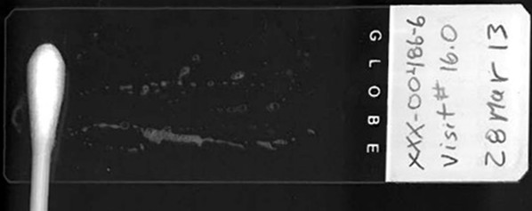
9.7 Gram stains on Vaginal Specimens
9.7.1 Gram Stains: For the lab assessment of Bacterial Vaginosis
Prepare 2 slides: One as Primary and the other as Secondary
Use a pencil to write the PTID and specimen collection date on one side of the frosted end of the slide. This is the side of the slide that the specimen is to be applied.

Slide 23
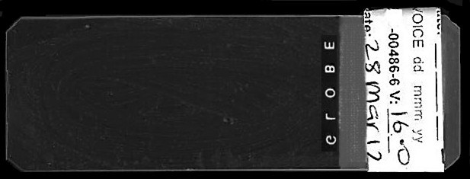
Collect from the lateral vaginal wall via swab (Dacron or cotton), roll the swab across each of the slides. (collect from opposite the vaginal wall used for the wet mount specimen collection.)
A SCHARP-provided PTID label is to be placed on the underside of the slides (on the frosted end, under the pencil markings); write the specimen collection date in indelible ink (e.g. pen) on each label.
Allow the specimens to air-dry on the slides. Do not heat-fix.
Notes:
Make sure to ‘roll’ the slide instead of ‘pushing’ across.

Slide 24
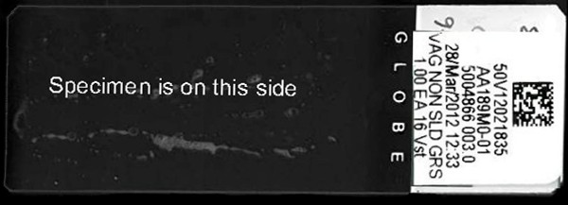
Gram Stain prep continued…
Vaginal smears for gram stain are to be logged into LDMS (specimen type = VAG). Place the LDMS label on the frosted end of the slide on top of the pencil markings (same side as sample).
Position primary slide in a plastic slide holder and sent to the MTN NL on the day when there is a culture collection.
Store the secondary slide in a slide box & store at room temp.

Slide 25
9.7.2 Vaginal Swab for Quantitative Culture
  Use Collection method supplied by LC:
    Max V (currently being used) or Port-A-Cul.
  Specimen must be refrigerated within 4 hours and shipped to NL with ice packs on the day of collection
  Ship the Port-A-Cul tube and the vaginal smear for gram stain the same day of collection by overnight courier.
Notes:
Try to collect culture swabs in an area on the lateral wall where other samples were not collected. This will help ensure an accurate culture will be produced for that participant.
Once collected, the kit can only stay at room temp for 4 hours before being refrigerated.

Slide 26
9.7.3 pH
    Use pH strips with range 3.6 to 6.1
    Do not insert the pH strip into the vagina
    Collect vaginal swab:
      Clinician collected with or without speculum
    Swab onto the pH strip
9.7.4 Vaginal Fluid Wet Mount Testing for BV & Yeast
    Perform wet mount only if indicated
    Saline wet mount for clue cells.
      Positive=20% clue cells per 400X
    KOH for yeast, only if indicated
      Positive=budding yeast cells or pseudohyphae

Slide 27
9.7.5 Rapid Trichomonas vaginalis test
  Collect specimen using kit-provided swab (OSOM Trichomonas kit).
  Collect sample from lateral vaginal wall from the posterior fornix.
  Do not collect specimens from the cervix
  Testing done at local lab/clinic lab
9.7.6 NAAT Chlamydia and Gonorrhea Testing
Sites can choose to use the BD Probetec, Gen Probe Aptima or GeneXpert.
Contact LC if your site does not perform one of these methods.
Procedure:
Collect vaginal sample (1 manufacturers recommended swab)
Transport according to the specific manufacturer’s recommendations.
Testing will be done at the local laboratories according to their site SOP.
Notes:
For NAAT testing: If the site does not have access to any of these tests, they can send the samples to the NL for testing. Contact the NL prior to sending specimens for GC/CT testing.

Slide 28
9.7.7 Vaginal Swab for Biomarkers
Collect vaginal fluid using a Dacron swab from the posterior fornix.
Place the swab in a labeled 1.5 ml micro tube containing 400 µL PBS
Break off swab shaft (use finger to prevent swab from ‘flying out’), and cap the vial.
Immediately refrigerate or place vial on ice and freeze at ≤-70°C within 8 hours of collecting the sample collection.
UAB: Biomarker shipments to LC should occur approximately every 2 months. The Dezzutti lab would like each participant to be tested within approximately one month after completing their Day 35.

Slide 29
9.7.8 Vaginal Swab for PK:
Sampling should not occur earlier than 8 hours after ring re-insertion.
  If this occurs, continue to collect samples and comment in LDMS & CRF.
At Enrollment and Day 28: Multiple-Time point collections
    Time 0 PK swab is collected before ring insertion or removal
    The timer begins upon ring insertion (ENR) or ring removal (Day 28).
    All serial collections are based on this time!
      If for some reason the blood draw is delayed or missed, it would have no bearing on the next time point.
    When each time point is due, blood will be drawn first, and then the participant will self-collect the PK swab within ~5 minutes.
      Mark all specimen collect times accurately. That way, if there are delays, the interval of time is logged.
      Time ‘0’ at the ENR visit: There is not a PK blood draw. Use additional time to instruct participant on self-collection.
Notes:
Example id there is a delayed blood draw: the ‘1 hour’ time-point draw was 15 minutes late [drawn at 75 minutes], the 2 hour PK blood would still be drawn at the 2 hour (120 minute) mark. If a collection is missed entirely, notify the MTN-027 management team.

Slide 30
ENR Specimen Flow Chart:
Urine hCG, Blood draw (AST, ALT, Creatinine, Plasma Archive, CBC w Diff & Plt, HIV [Rapid Test]) a
speculum a
PE a
pH, Culture swabs, Gram stain swab, Biomarker swab, Cytobrush a
removal speculum a
insertion of anoscope (with ppt consent) a
Rectal sponge a
remove anoscope a
Eligibility/Randomization a
Collect Vag PK self-collect swab ( hour 0) a
Ring insertion (timer starts) a
exam to check ring placement (no speculum needed) a
collect remaining serial PK samples relative to timing of ring insertion

Slide 31
Self-collection of the Vaginal Swab for PK continued…
Single time points:
  The blood is drawn, and then the participant should collect the self-collected swab within ~1 hour.
  For the first 8 participants on Visit days 1 & 7, the participant will be collecting 3 swabs, one after the other.

Slide 32
Self-collection of the Vaginal Swab for PK continued…
Scale Readiness:
  Day of sample collection:
    Gloves are always worn when touching anything to be weighed!
    QC is performed.
    Use the same scale for both pre & post weights.
    Do not turn off balance until the pre & post-weights for that day are completed.
    Have Tracking Sheets ready for pre-weights if not using a log sheet
    Pre-weights are determined before participant arrives
    For the self-collection bags:
      Make sure Zip-lock bags & cryovials have clear identification…marked with PTID labels.
      Use a light weight container on scale to place items in.
      Extra zip-Lock bag(s) will need to be prepared incase of an accident (swab is dropped, shaft splinters, etc.)
      Mark all Pre-Weights on bag.
Notes:
Light weight container (e.g. urine cup)
Make sure all bags are marked clearly so the wrong bag is not inadvertently picked up with the wrong pre-weight.

Slide 33
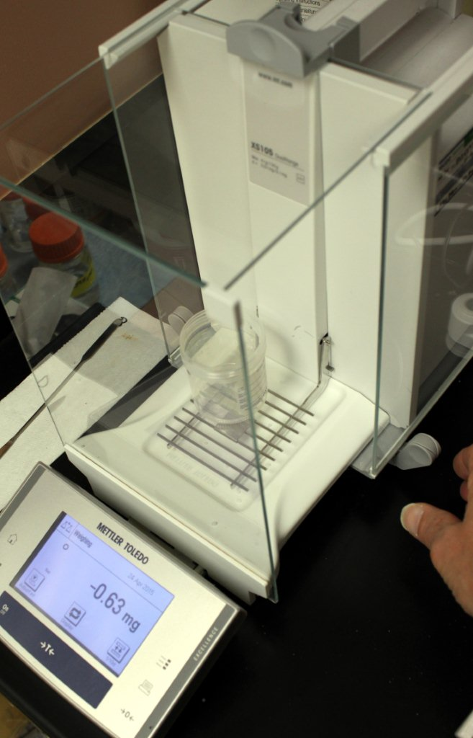
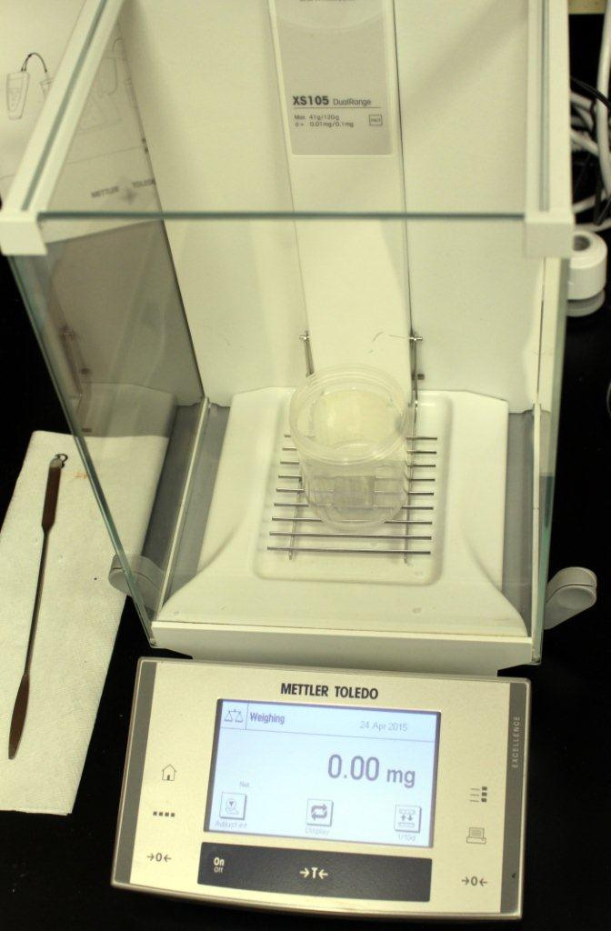
Few tips about scales:
Incorrect way to tare a container (e.g. urine container) :
  Container NOT centered on weighing plate
  Gloves are NOT being used
  Doors are open (you can see, it’s actually having a hard time zeroing).
Correct way to Tare a container:
  Cup is centered,
  Doors closed,
  Gloves keeps all surfaces clean
  Gave enough time to equilibrate

Slide 34
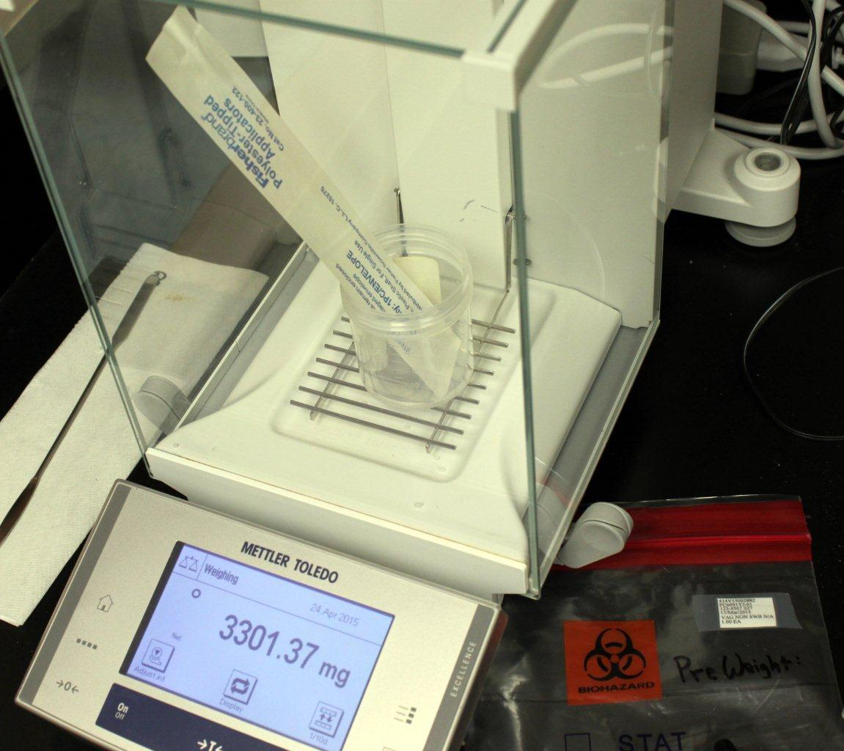
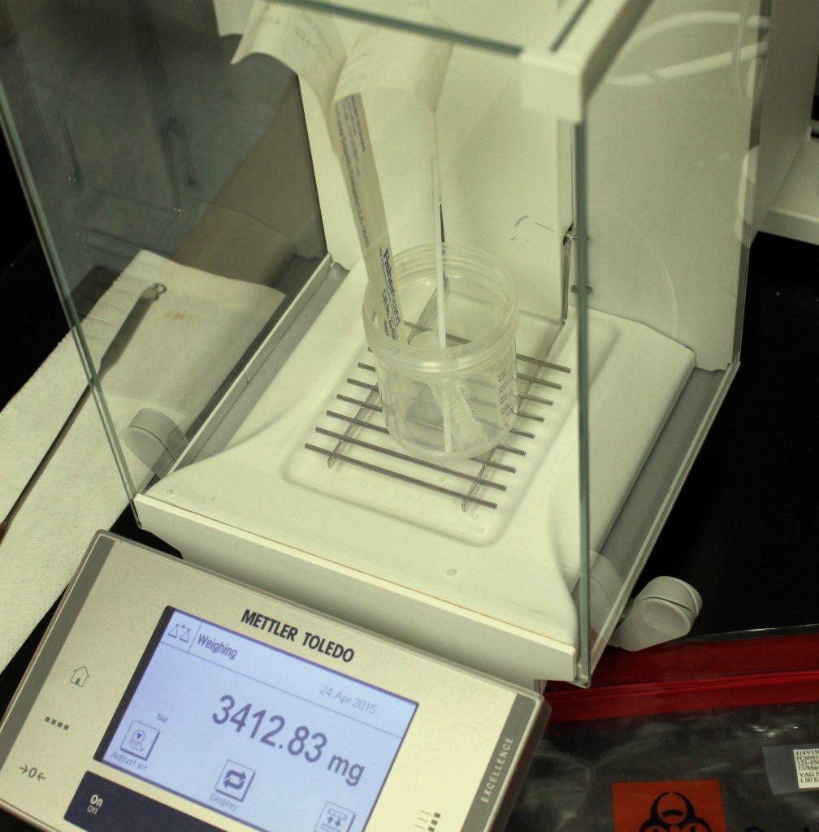
Pre-Weight:
This could have been better…
  Make sure swab envelope does not touch glass sides, try to make everything stand straight up.
Write pre-weight on bag
Post-Weight:
This is good…
Everything standing straight up, doors closed, gave it a minute to settle down.
Record pre & post weight on tracking sheet.
Make sure you have a positive # that makes sense (in this example: 3412.3-3301.4=110.9 mg)
The average weight we’ve seen is ~81 mg. Ranges we’ve seen are 65 to 115.

Slide 35
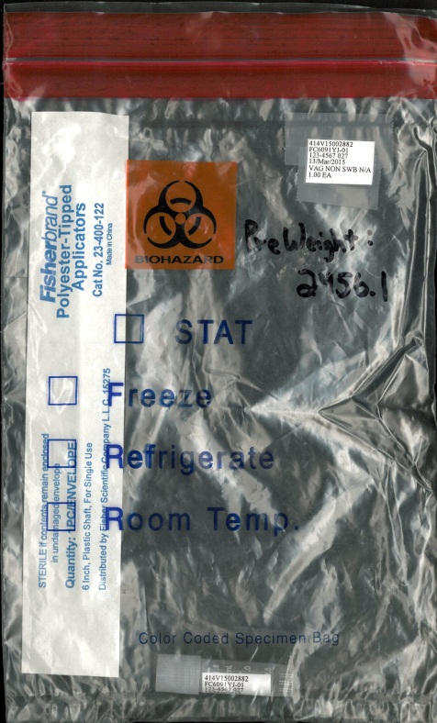
Pre & Post weight procedures:
  are detailed in Lab SSP
  Organization is key!!
For multiple time-point visits, make sure all bags are marked with a time.
(example… Collection Time: 0)
Collection Time = 0

Slide 36
9.7.8 Self Collected Swab Collection :
Performed at each designated time-point.
Instruct the patient on how to collect the sample
  Use Illustration found in the Study Implementation Materials to help explain process.
Site has option to have staff or participant break shaft.
Everything gets placed back into the bag (you may want to remove trash cans from patient area).
Make sure cap in on tight!
If a swab hits the ground, or the shaft is splintered, have a back-up kit ready.
Notes:
If a swab is dropped on the ground…they will have to start from the beginning with a new collection kit.

Slide 39
Vaginal Swab for PK continued…
Post Weighing & final processing of PK swabs:
  Record post weight on tracking sheet
  Freeze at <-70˚C within 2 hours of collection.
LDMS Processing lab:
  Enter pre-& post weights on LDMS EXCELL worksheet
    The worksheet will provide the Net-Weight
    Check against the tracking sheet
    Enter Net-Weight into LDMS (see section 9.4 in Lab SSP)
Notes:
Important note for clinicians: Subsequent specimens must be collected away from the previously contacted mucosal surface where the PK swab was collected.

Slide 40
9.7.9 Testing of Intravaginal Ring (VR)
Collection & Processing of the rings for residual drug analysis.
Step 1: Clinician will remove the used ring and place in a clean container with water (can be tap water).
  Move the ring around in the water to remove vaginal material.
  Take the ring out of the water and blot dry with paper towels or gauze.
    The ring should be dry before storing in pouch.
  If the ring is removed by the participant prior to the clinic visit and will not be reinserted, then the used ring is still prepared for residual drug analysis.
Notes:
All used rings go back to the lab for residual analysis!

Slide 41

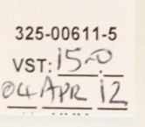
Testing of Intravaginal Ring (VR) for Residual PK
Step 2: Site staff will place the dry ring into a new 3”X5” amber Zippit pouch.
  Label the pouch with the participant ID number and visit number.
  Add a biohazard sticker if one is not already attached to the pouch.
Step 3: Store the used ring within the biohazard labeled amber pouch at room temperature.
Step 4: Use LDMS to log in all used rings.
Step 5: At the end of the study, LC will contact site to coordinate shipment.
Notes:
Use a disposable container or a reusable container that was cleaned using 10% bleach solution for 20 minutes.
Do not use the pouch that the participant brought in. That pouched may have already been used and contaminated.

Slide 42
9.8.1 Cervical Biopsy
  Collected on Day 28, shortly after ring removal.
    Pitt will collect 2 Cervical Biopsies
    UAB will collect 1 Cervical Biopsy
9.8.2 Cervical Biopsy for PD (ex vivo challenge, Pitt only)
  Collect 1 fresh biopsy at visit day 28 using forceps
  Insert into a 2 mL Corning (orange cap) cryovial with 1 mL of cold biopsy transport medium (kept at 4°C).
  Drop tissue directly into transport media by gently shaking tube until biopsy is dislodged from forceps.
  Transport to MTN Dezzutti lab…Immediately!
Notes:
To mention (maybe just verbally) that the biopsies and rectal fluid are collected during Day 28 Pelivc exam. This means that they will be collected shortly after ring removal, and this is fine (amount of time between ring remocal and sample collection is negligible).

Slide 43
9.8.3 Cervical Biopsy for PK (Pitt & UAB)
  One biopsy will be collected for a tissue PK level at Visit day 28.
  Use a 2 mL Nalgene cryovial
  Samples will be Pre & Post weighted
    Record on LDMS Tracking sheet (and on excel worksheet)
  Immediately freeze the cryovial containing the PK biopsy with either method:
    Dry ice ethanol bath (dry ice with enough ethanol to make a slushy consistency)
    Liquid Nitrogen
  Store biopsies at <-70ºC.
  Document date & time frozen on LDMS tracking sheet

Slide 44
Cytobrush
For Flow Cytometry at Pittsburgh
Use the Cytobrush Plus ordered from Cooper Surgical: (catalog number: C0104)
Specimen Collection Procedure:
  Collect sample using cytobrush by inserting into the cervical os and perform 2 - 360° turns.
  Immediately place cytobrush into appropriately labeled 50 mL screw cap conical vial containing 20 mL of tRPMI.
  Break off or use scissors to remove about 2 inches from the end of the shaft so the cytobrush can fit into the 50 mL vial and still be capped.
  Keep on wet ice or refrigerate until specimen is processed.
  Processing should occur within 2 hours of obtaining sample.
    Follow communication flow chart
Notes:
Caterpillar brush
Pitt has communication flow sheet

Slide 45
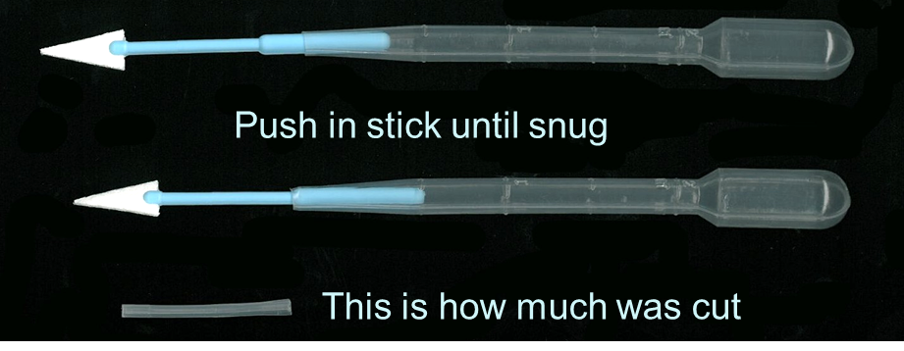
9.10 Collection of Rectal Fluid
Preparation of Materials (1-2 hours prior to procedure):
  While wearing gloves, remove sponge from package and label 5 mL cryovial.
  Weigh the sponge (connected to the sponge stick) and 5 mL cryovial.
  Record the pre-weight on the LDMS tracking sheet.
  Prepare a sponge holder (also called an insertion tube) using a sterile plastic transfer pipette by cutting off the end approximately 1 inch from the tip.
NOTE: Make sure that the stem of the sponge will fit into the pipette snugly so that it will not dislodge during insertion or extraction from the rectal cavity.

Slide 46
Rectal Sample Collection Procedure (this is more detailed in lab SSP)
Use the Good Clean Love lubricate on the anoscope.
Slowly insert the anoscope with obturator in place through the anus and advance the instrument until the flange is flush with the subject’s skin.
Remove obturator.
Introduce the sponge (attached to the pipette sponge holder extension)
Record the time onto the LDMS Specimen Tracking Sheet
Hold (or leave) sponge in place for 2 minutes.
Disengage sponge from holder (plastic pipette) and discard holder.
Immediately place the sponge in the 5ml cryovial and cap (to avoid evaporation).
Slowly remove anoscope.
Post-Weigh the cryovials with sponge (including the sponge stick) & record.
Place on ice immediately and freeze at ≤-70˚C within 4 hours.
All pre and post weights are logged by the processing lab onto an excel weight worksheet & entered into the LDMS system.
At the end of the study, the LC will contact site to coordinate shipment.

Slide 47

Supplies
Wayne
Review the excel Inventory list
Contact LC if anything is required

Slide 48
MTN Network Contacts
  Wayne Hall 412-641-6956
  hallwb@mwri.magee.edu
  Lorna Rabe
  412-641-6041 lrabe@mwri.magee.edu
  May Beamer
    mbeamer@mwri.magee.edu
  Stress Therapy
    Drink-shot-of-Fireball@works everytime.com

Slide 49

Pittsburgh like 2 weeks ago…

Slide 50

Today
Questions?

